Slide 1


Lecture 28
Produced by Dr. Worldwide
Welcome to the 305
~
~

Slide 2



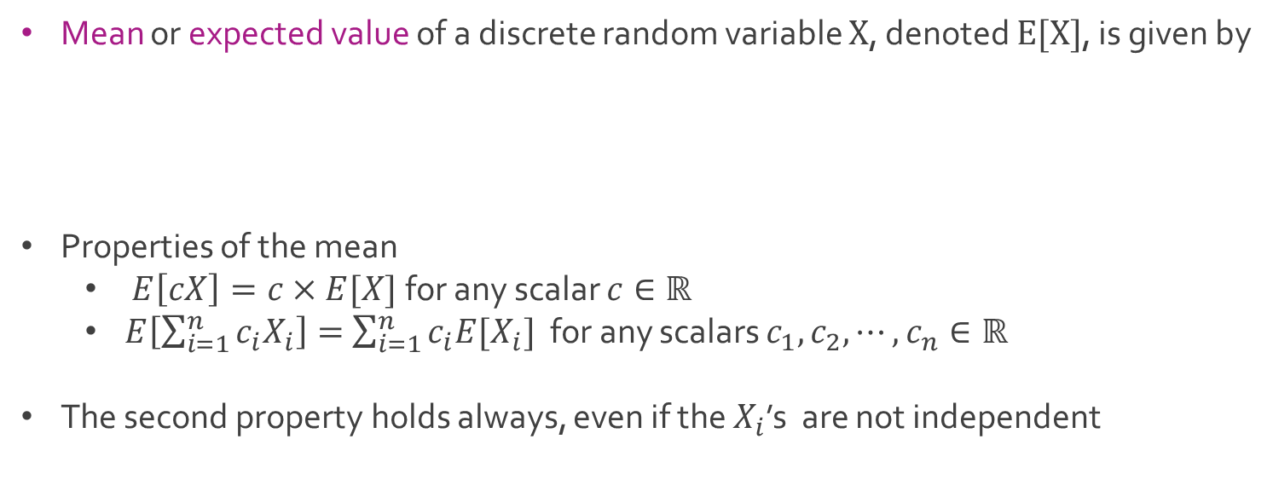
Discrete Random Variable
Mean or expected value of a discrete random variable $X$, denoted $E[X]$, is given by
Properties of the mean
$E\left[cX\right]=c×E[X]$ for any scalar $c∈ℝ$
$E\left[\sum_{i=1}^{n}{c_{i}X_{i}}\right]=$ $\sum_{i=1}^{n}{c_{i}{E[X}_{i}]}$ for any scalars $c_{1},c_{2}, ⋯,c_{n}∈ℝ$
The second property holds always, even if the $X_{i}$’s are not independent
$$E\left[X\right]=\sum_{i=1}^{∞}{x_{i}p\left(x_{i}\right)}$$

Slide 3
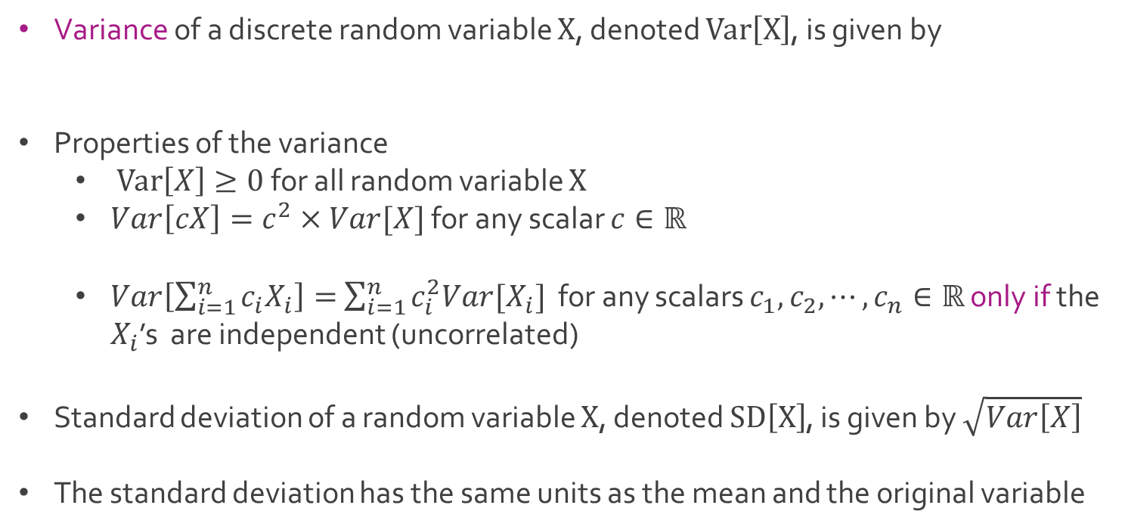
Discrete Random Variable
Variance of a discrete random variable $X$, denoted $Var\left[X\right]$, is given by
Properties of the variance
$Var\left[X\right]≥0$ for all random variable $X$
$Var\left[cX\right]=c^{2}×Var[X]$ for any scalar $c∈ℝ$
$Var\left[\sum_{i=1}^{n}{c_{i}X_{i}}\right]=$ $\sum_{i=1}^{n}{c_{i}^{2}{Var[X}_{i}]}$ for any scalars $c_{1},c_{2}, ⋯,c_{n}∈ℝ$ only if the $X_{i}$’s are independent (uncorrelated)
Standard deviation of a random variable $X$, denoted $SD\left[X\right]$, is given by $\sqrt{Var\left[X\right]}$
The standard deviation has the same units as the mean and the original variable
$$Var\left[X\right]=E\left[{\left(X−E\left[X\right]\right)}^{2}\right]=E\left[X^{2}\right]−{\left(E\left[X\right]\right)}^{2}$$

Slide 4
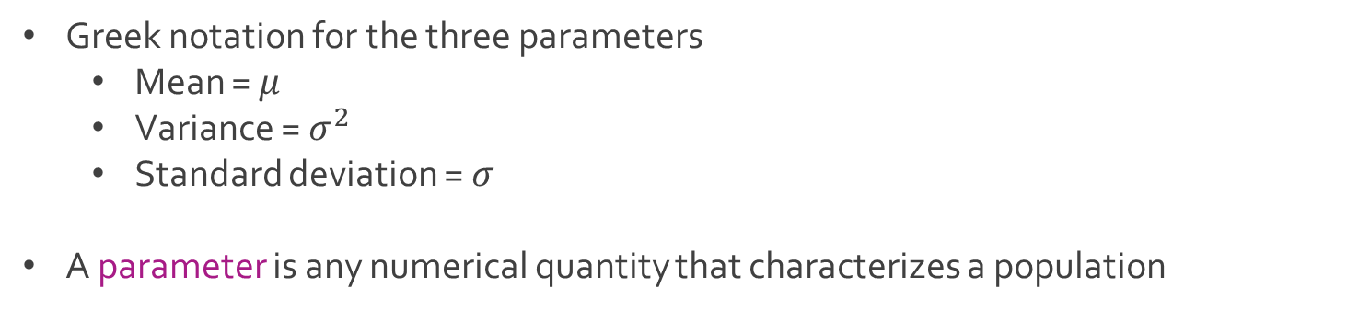
Discrete Random Variable
Greek notation for the three parameters
Mean = $μ$
Variance = $σ^{2}$
Standard deviation = $σ$
A parameter is any numerical quantity that characterizes a population

Slide 5
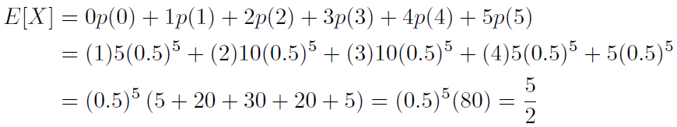

Ex: Tossing Coin
Suppose $X=Number of Heads in 5 Coin Tosses$
The pmf $p(X)$ can be calculated according to the binomial distribution
Q: What is the mean $μ_{x}$, variance $σ_{x}^{2}$, and standard deviation $σ_{x}$ of $X$?
Calculation of $μ_{x}$

Slide 6
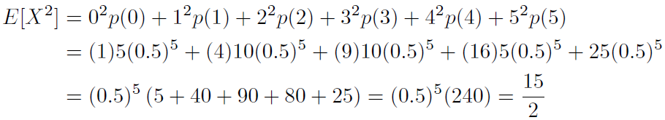


Ex: Tossing Coin
For variance, we first calculate $E\left[X^{2}\right]$
Then, we calculate $σ_{x}^{2}=Var\left[X\right]=E\left[X^{2}\right]−{\left(E\left[X\right]\right)}^{2}$
Download TossingCoin.xlsx from link Sheet 1 on course website
Calculation of mean, variance, and standard deviation in Excel

Slide 7
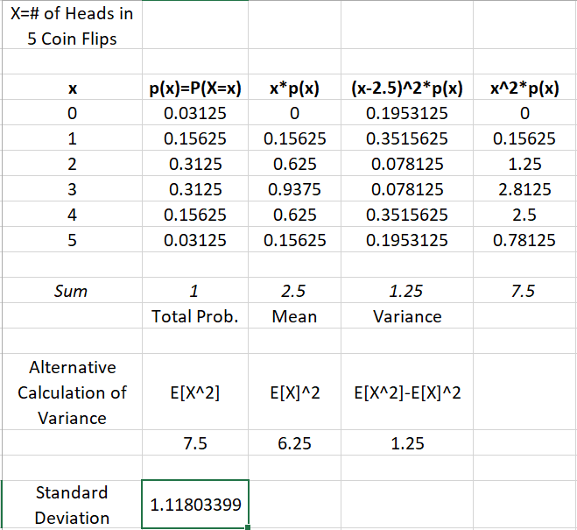
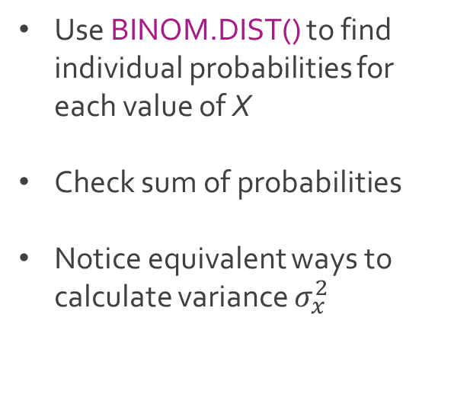
Ex: Tossing Coin
Use BINOM.DIST() to find individual probabilities for each value of X
Check sum of probabilities
Notice equivalent ways to calculate variance $σ_{x}^{2}$

Slide 8


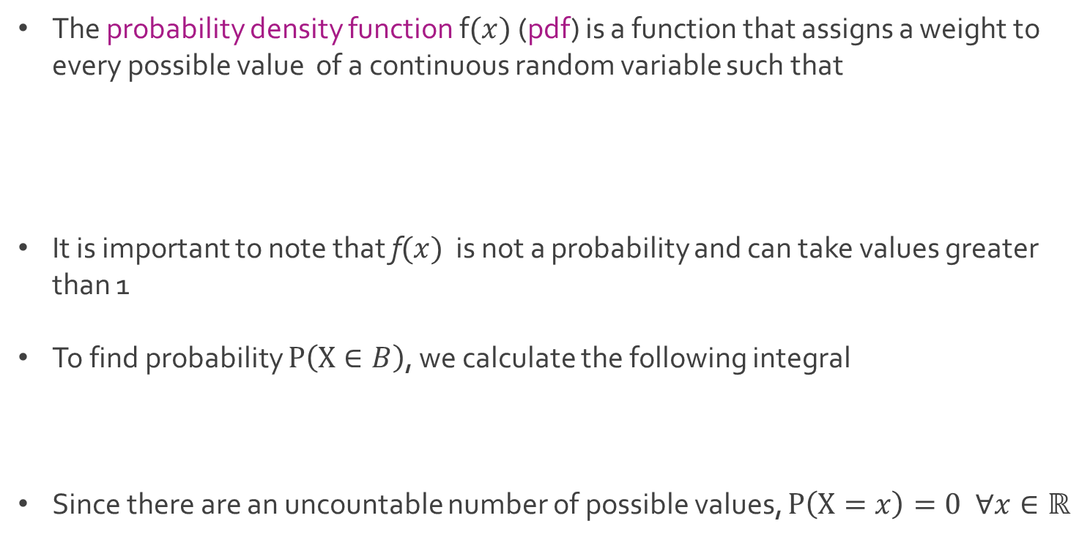
Continuous Random Variable
The probability density function f$(x)$ (pdf) is a function that assigns a weight to every possible value of a continuous random variable such that
It is important to note that f$(x)$ is not a probability and can take values greater than 1
To find probability $P\left(X∈B\right)$, we calculate the following integral
Since there are an uncountable number of possible values, $P\left(X=x\right)=0 ∀x∈ℝ$

Slide 9
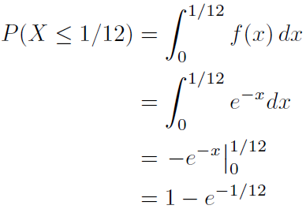
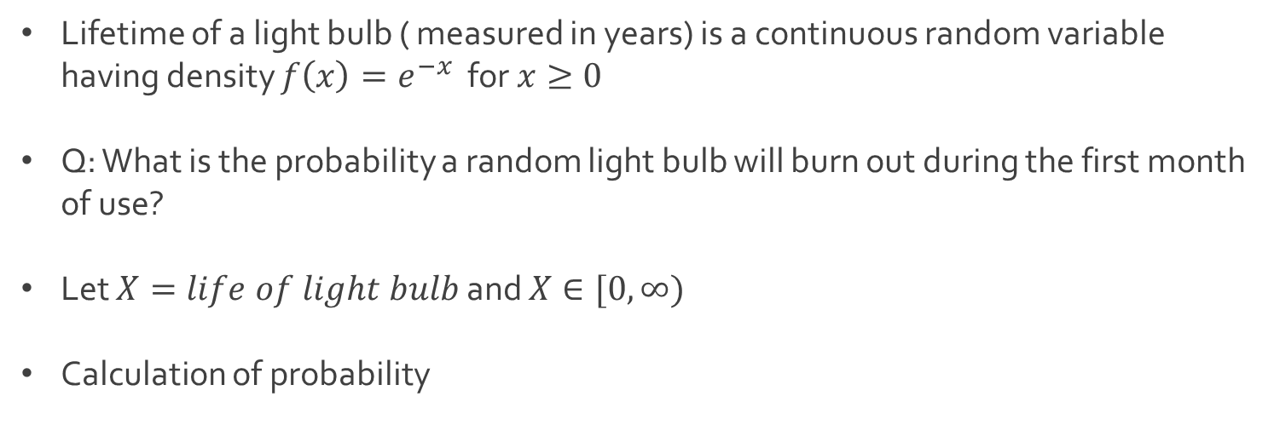
Ex: Light Bulb Lifespan
Lifetime of a light bulb ( measured in years) is a continuous random variable having density $f\left(x\right)=e^{−x}$ for $x≥0$
Q: What is the probability a random light bulb will burn out during the first month of use?
Let $X=life of light bulb$ and $X∈[0,∞)$
Calculation of probability

Slide 10
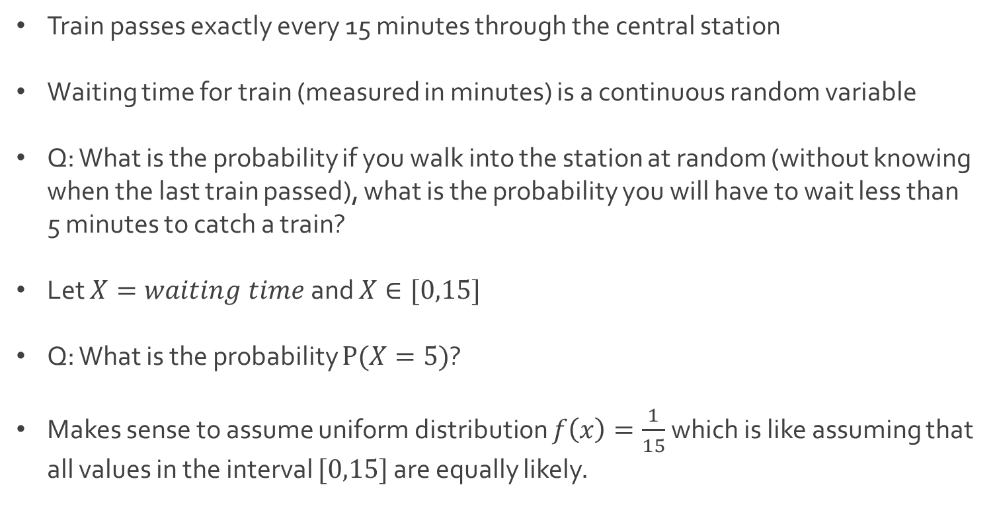
Ex: Waiting Time
Train passes exactly every 15 minutes through the central station
Waiting time for train (measured in minutes) is a continuous random variable
Q: What is the probability if you walk into the station at random (without knowing when the last train passed), what is the probability you will have to wait less than 5 minutes to catch a train?
Let $X=waiting time$and $X∈[0,15]$
Q: What is the probability $P(X=5)$?
Makes sense to assume uniform distribution $f\left(x\right)=\frac{1}{15}$ which is like assuming that all values in the interval $[0,15]$ are equally likely.

Slide 11
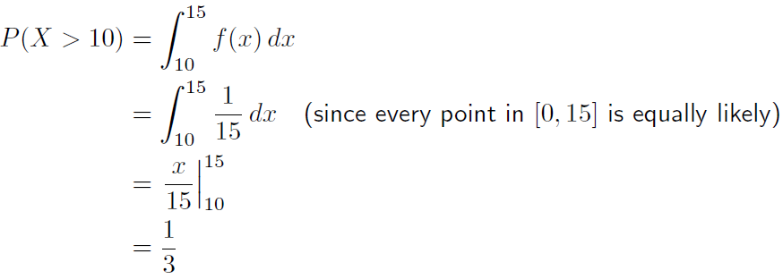
Ex: Waiting Time
Calculation of probability

Slide 12

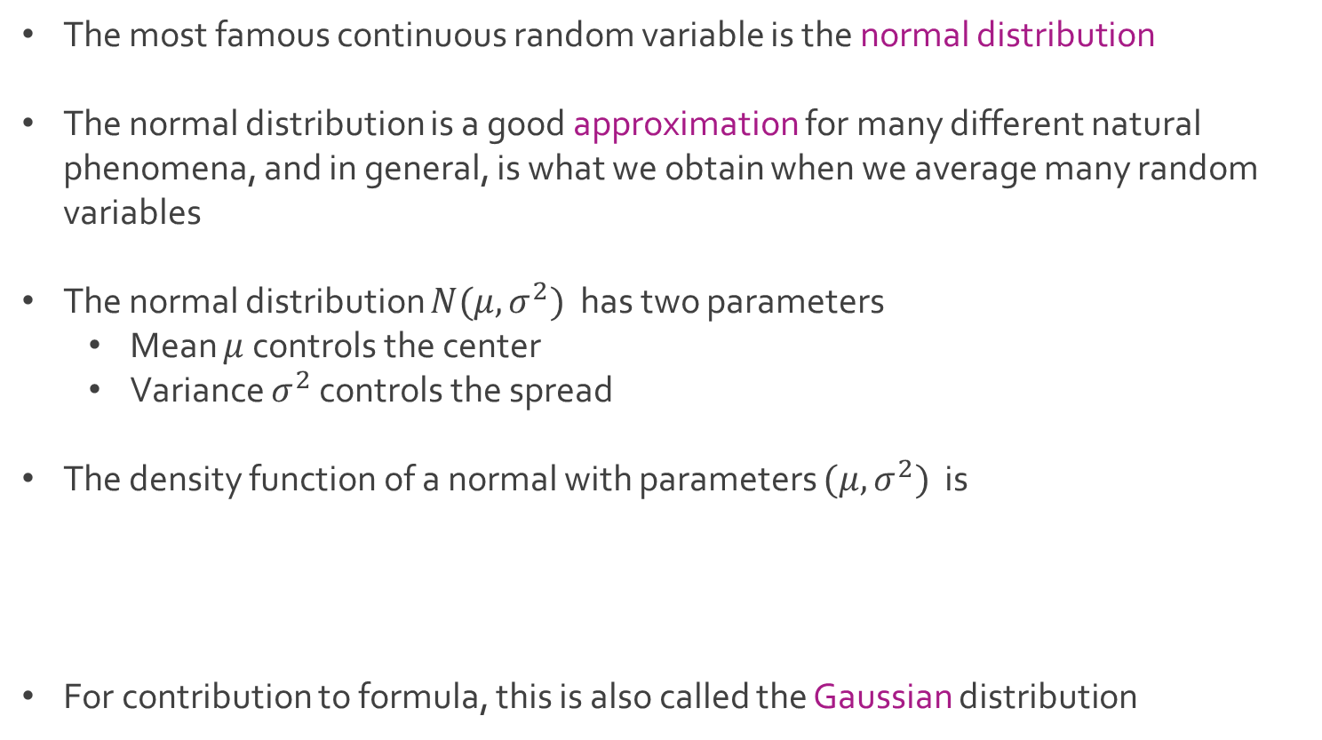
Normal Distribution
The most famous continuous random variable is the normal distribution
The normal distribution is a good approximation for many different natural phenomena, and in general, is what we obtain when we average many random variables
The normal distribution $N(μ,σ^{2})$ has two parameters
Mean $μ$ controls the center
Variance $σ^{2}$ controls the spread
The density function of a normal with parameters $(μ,σ^{2})$ is
For contribution to formula, this is also called the Gaussian distribution

Slide 13
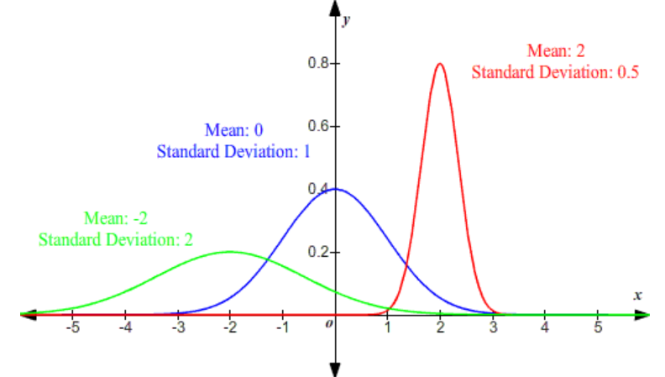
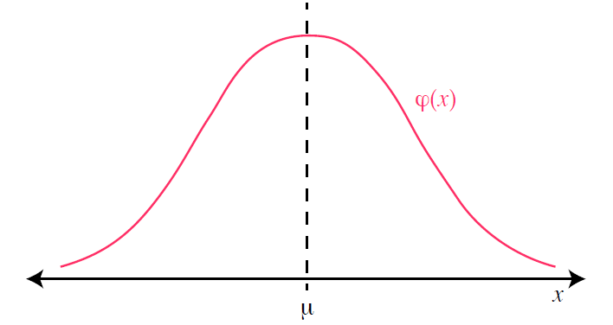
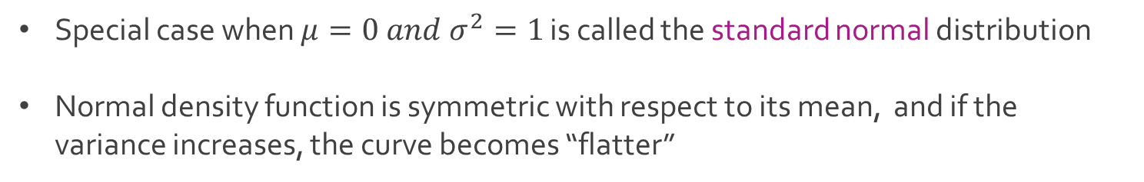
Normal Distribution
Special case when $μ=0 and σ^{2}=1$ is called the standard normal distribution
Normal density function is symmetric with respect to its mean, and if the variance increases, the curve becomes “flatter”

Slide 14
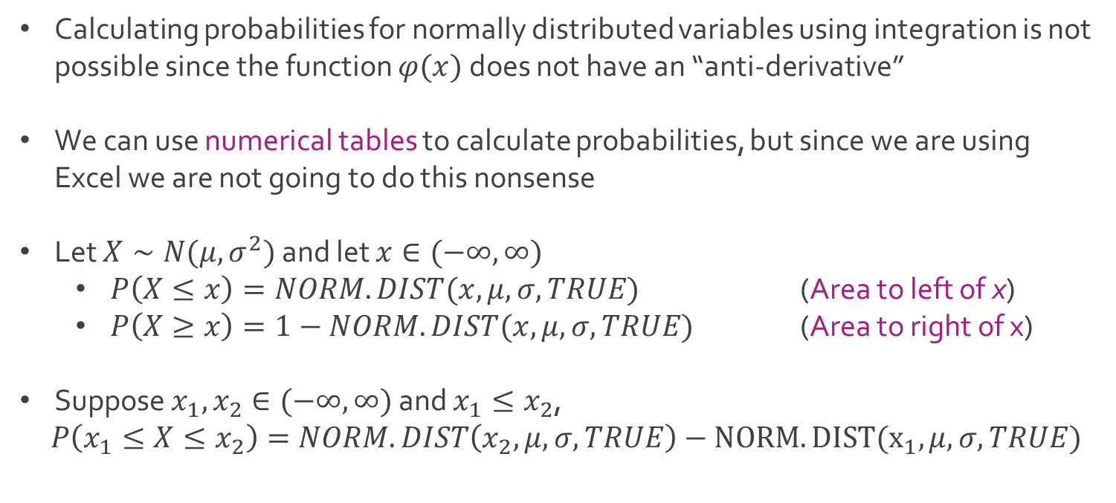
Normal Distribution
Calculating probabilities for normally distributed variables using integration is not possible since the function $φ(x)$ does not have an “anti-derivative”
We can use numerical tables to calculate probabilities, but since we are using Excel we are not going to do this nonsense
Let $X∼N(μ,σ^{2})$ and let $x∈(−∞,∞)$
$P\left(X≤x\right)=NORM.DIST(x,μ,σ,TRUE)$ (Area to left of x)
$P\left(X≥x\right)=1−NORM.DIST(x,μ,σ,TRUE)$ (Area to right of x)
Suppose $x_{1},x_{2}∈(−∞,∞)$ and $x_{1}≤x_{2}$,
$P\left(x_{1}≤X≤x_{2}\right)=NORM.DIST\left(x_{2},μ,σ,TRUE\right)−NORM.DIST(x_{1},μ,σ,TRUE)$

Slide 15
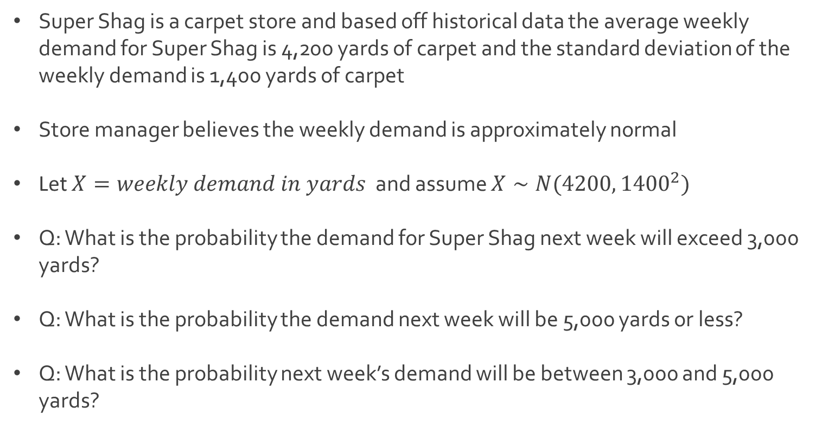
Ex: Carpet Store
Super Shag is a carpet store and based off historical data the average weekly demand for Super Shag is 4,200 yards of carpet and the standard deviation of the weekly demand is 1,400 yards of carpet
Store manager believes the weekly demand is approximately normal
Let $X=weekly demand in yards$ and assume $X∼N(4200, {1400}^{2})$
Q: What is the probability the demand for Super Shag next week will exceed 3,000 yards?
Q: What is the probability the demand next week will be 5,000 yards or less?
Q: What is the probability next week’s demand will be between 3,000 and 5,000 yards?

Slide 16
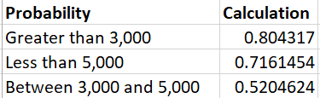
Ex: Carpet Store
Download Shaggy.xlsx from link Sheet 2 on course website
Observe the formulas for the calculation of our 3 probabilities

Slide 17
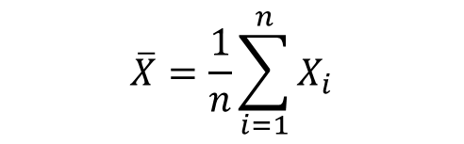
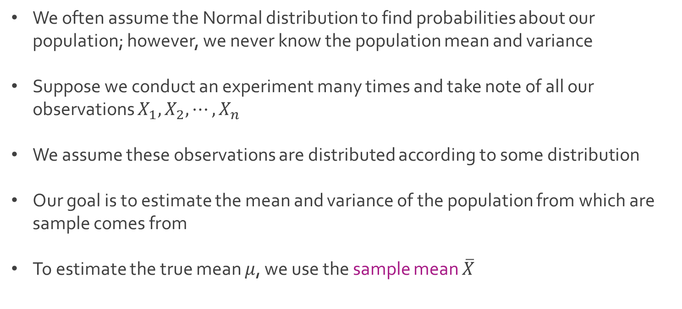
Sample Statistics
We often assume the Normal distribution to find probabilities about our population; however, we never know the population mean and variance
Suppose we conduct an experiment many times and take note of all our observations $X_{1},X_{2},⋯, X_{n}$
We assume these observations are distributed according to some distribution
Our goal is to estimate the mean and variance of the population from which are sample comes from
To estimate the true mean $μ$, we use the sample mean $\overline{X}$
$$\overline{X}=\frac{1}{n}\sum_{i=1}^{n}{X_{i}}$$

Slide 18
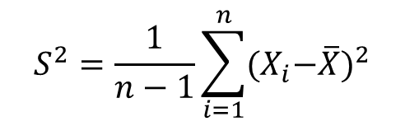
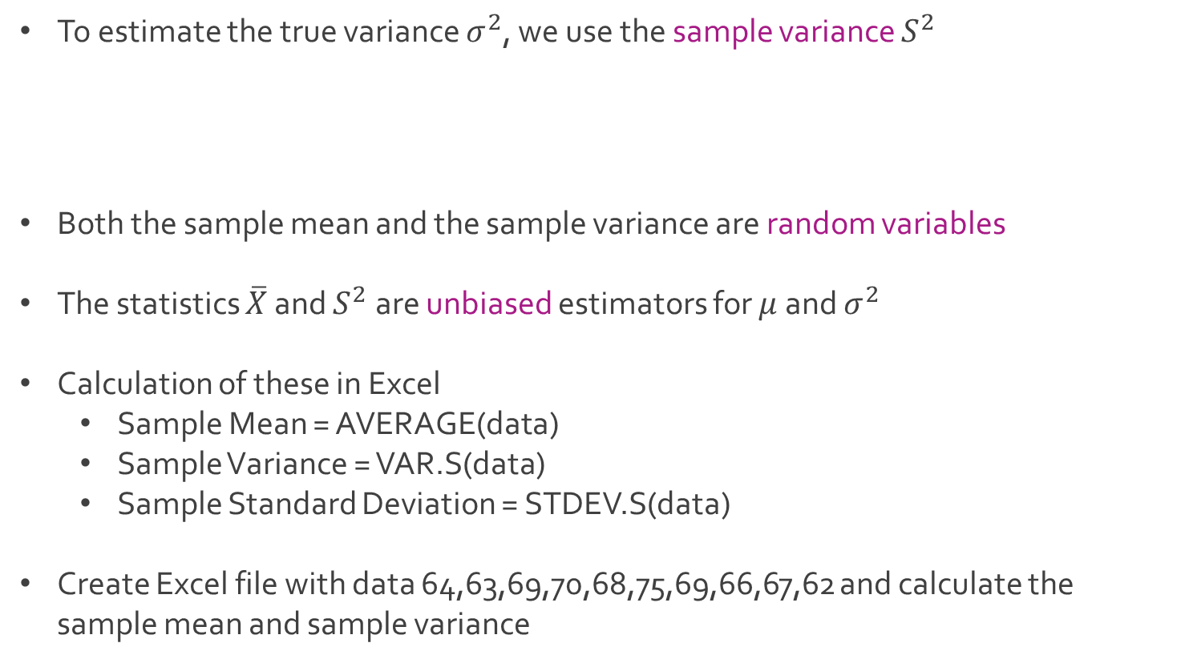
Sample Statistics
To estimate the true variance $σ^{2}$, we use the sample variance $S^{2}$
Both the sample mean and the sample variance are random variables
The statistics $\overline{X}$ and $S^{2}$ are unbiased estimators for $μ$ and $σ^{2}$
Calculation of these in Excel
Sample Mean = AVERAGE(data)
Sample Variance = VAR.S(data)
Sample Standard Deviation = STDEV.S(data)
Create Excel file with data 64,63,69,70,68,75,69,66,67,62 and calculate the sample mean and sample variance
$$S^{2}=\frac{1}{n−1}\sum_{i=1}^{n}{{{(X}_{i}−\overline{X})}^{2}}$$

Slide 19




The End
Dale

